Slide 1

Genome-Phenome analysis of neoplasm-related traits across the primate phylogeny
19-07-2021
Alejandro Valenzuela, David Juan, Gerard Muntané, Arcadi Navarro
Comparative and evolutionary genomics lab

Slide 2
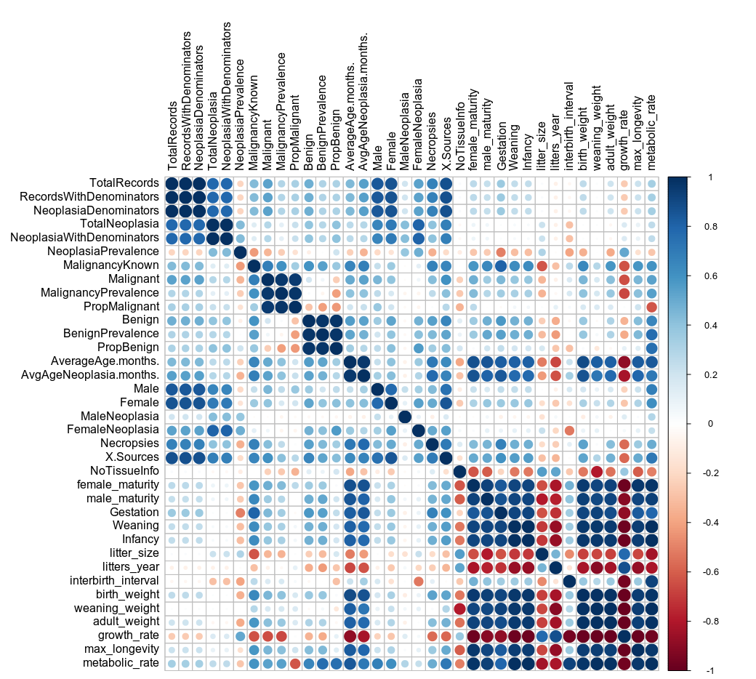
Neoplasm proportions as phenotypes of interest
Started working with 3 main clusters of neoplasm rates:
A) General Neoplasy
B) Malignancy
C) Benignancy
A
We focus on protein-coding regions and the search for correlations between rates of protein evolution and these traits, using Phylogenetic-Generalized
Least Squares (PGLS).
We use a new dataset, with means from species with 10 or more observations.
B
C

Slide 3
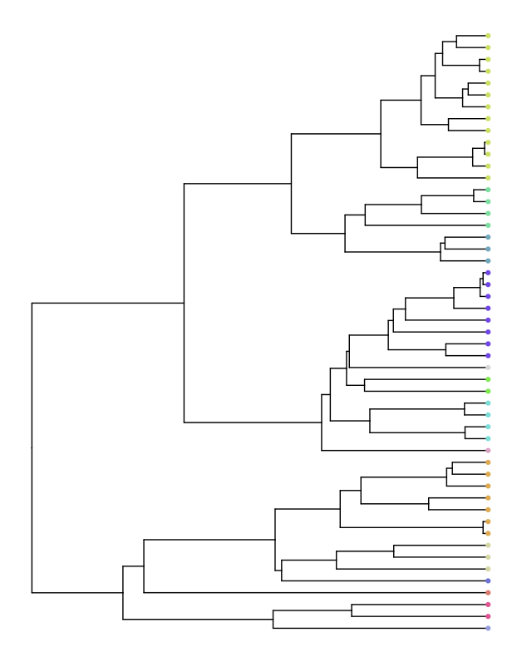
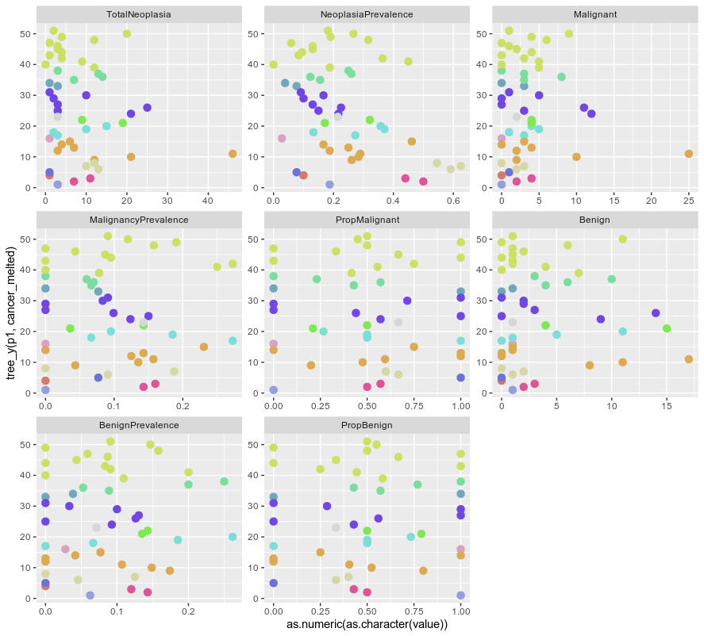
We observe extreme species within primate family clades (as we did with the previous dataset)

Slide 4
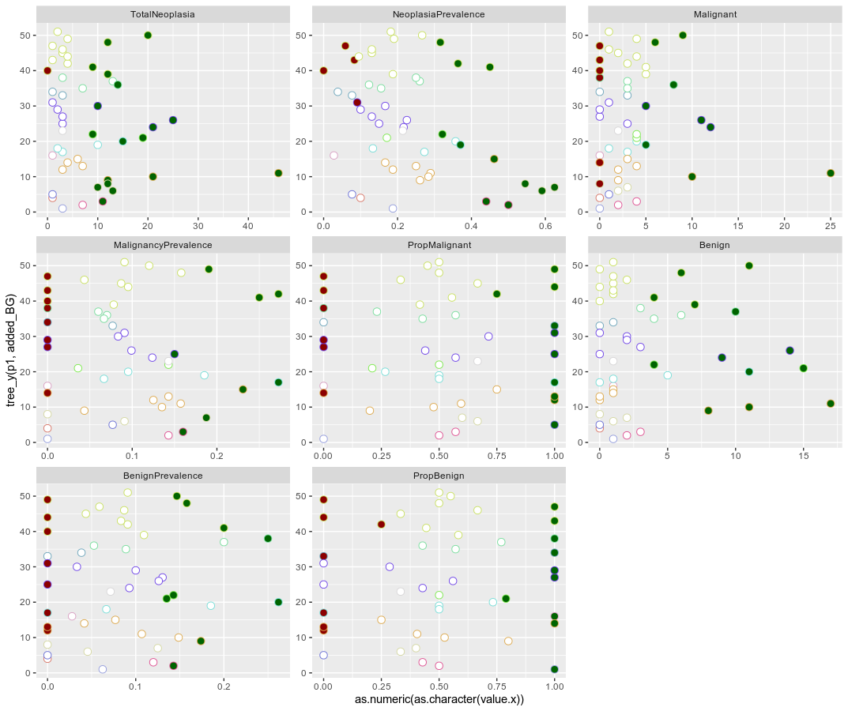
We observe extreme species within primate family clades (as we did with the previous dataset)

Slide 5

Data quality: a new balance
With the new filtering at the species level, there are two different impacts:
Reduction at the species-level accuracy. Representative species from the same genus are selected.
Improvement of the trait dataset quality, with more reliable measurements as mean species values.
10 measurements x species,
balanced trade off

Slide 6
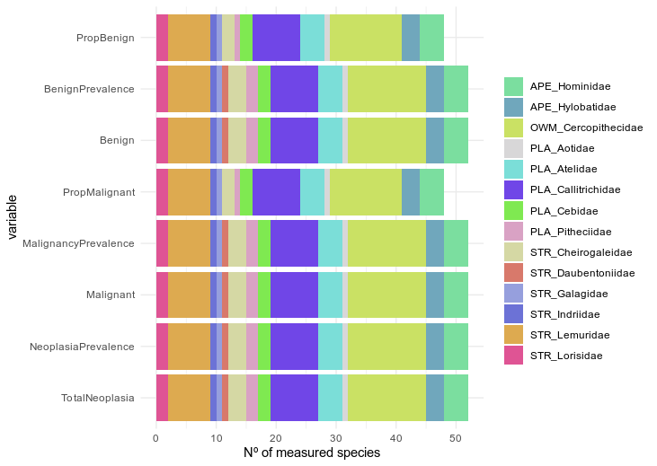
Data quality: a new balance
With the new filtering at the species level, there are two different impacts:
Reduction at the species-level accuracy. Representative species from the same genus are selected.
Improvement of the trait dataset quality, with more reliable measurements as mean species values.
52 primate species
14 primate families

Slide 7
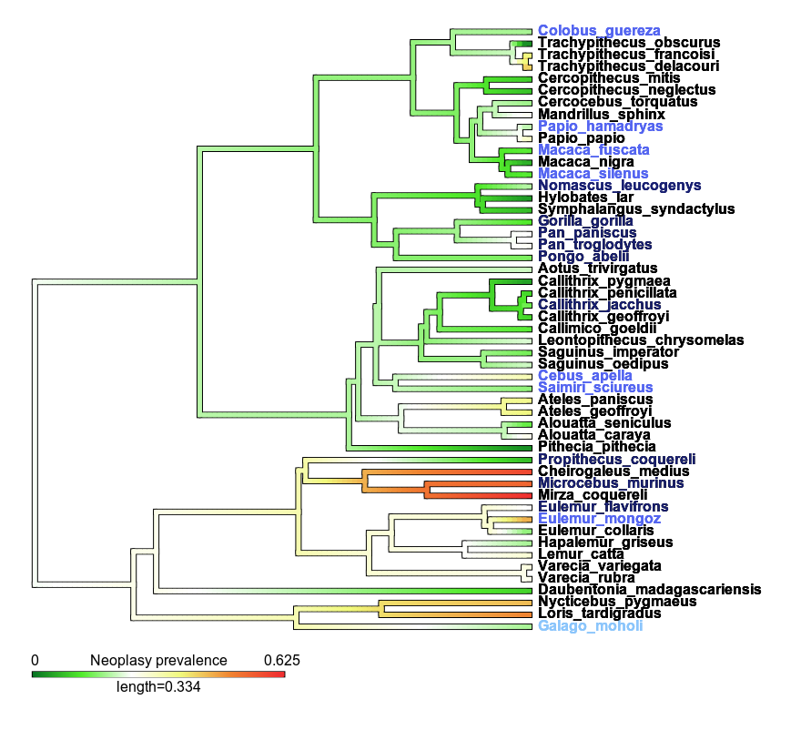
Available Genomes
9 species with
available UCSC genomes
7 species with genomic data for closest genus representative
1 species with genomic data for closest family representative

Slide 8
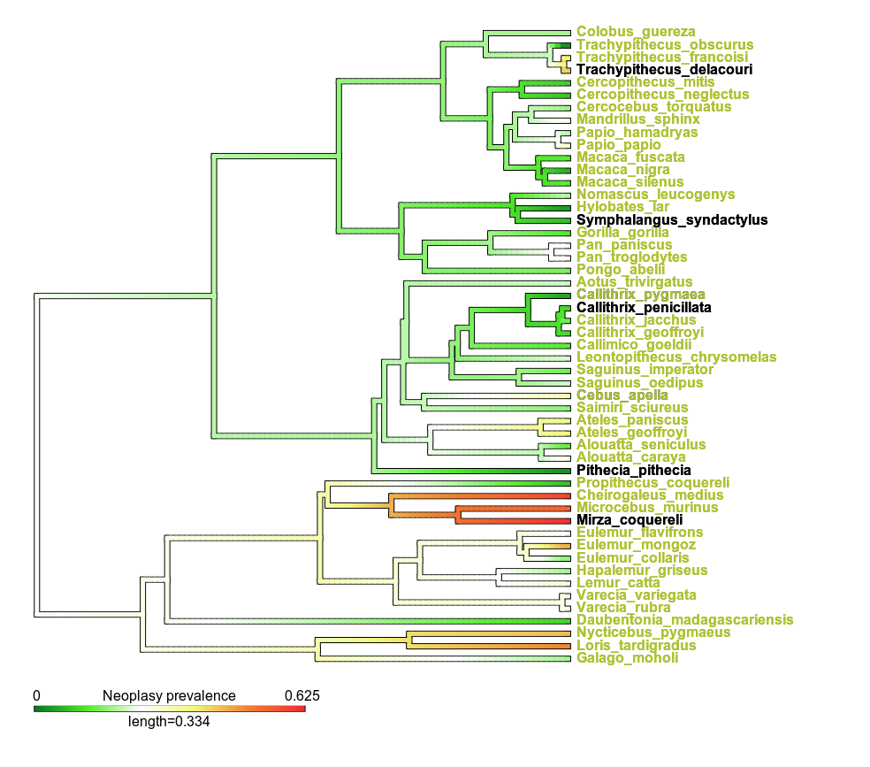

Eventually, adding...
~37 species with genomic data for genomes coming from the
Primate Sequencing Initiative Consortium (PSIC)

Slide 9
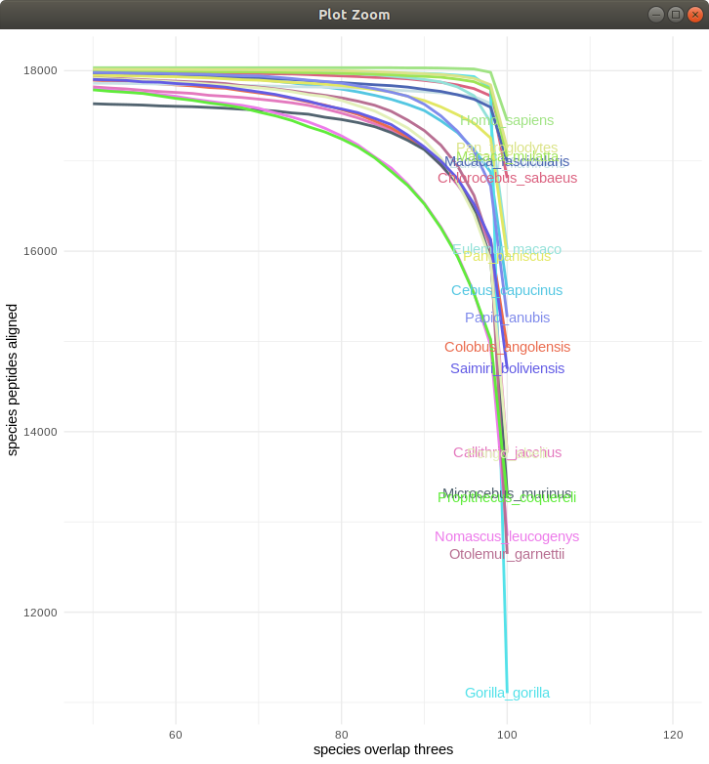
Final genomic dataset
The analyzed dataset is formed by 16,343 best quality transcript alignments representing a human gene.
This has been used as our genomic dataset for trait analysis.

Slide 10
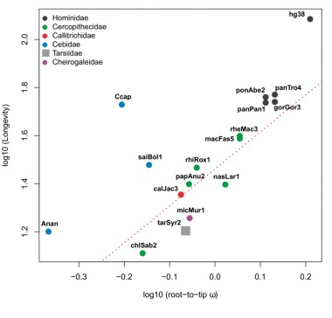
PGLS-based trait-association analysis
(Phylogenetic generalised least-squares, PGLS)
Regression between a genomic variable (in our case, rates of protein evolution, measured as root-to-tip dN/dS) and a trait response variable (e.g., neoplasia rate) across a phylogeny, controlling for non-independence of species data points.
gene-trait correlations
gene-trait correlations
Muntané et al. (2018). Biological processes modulating longevity across primates: A phylogenetic genome-phenome analysis. Molecular Biology and Evolution

Slide 11
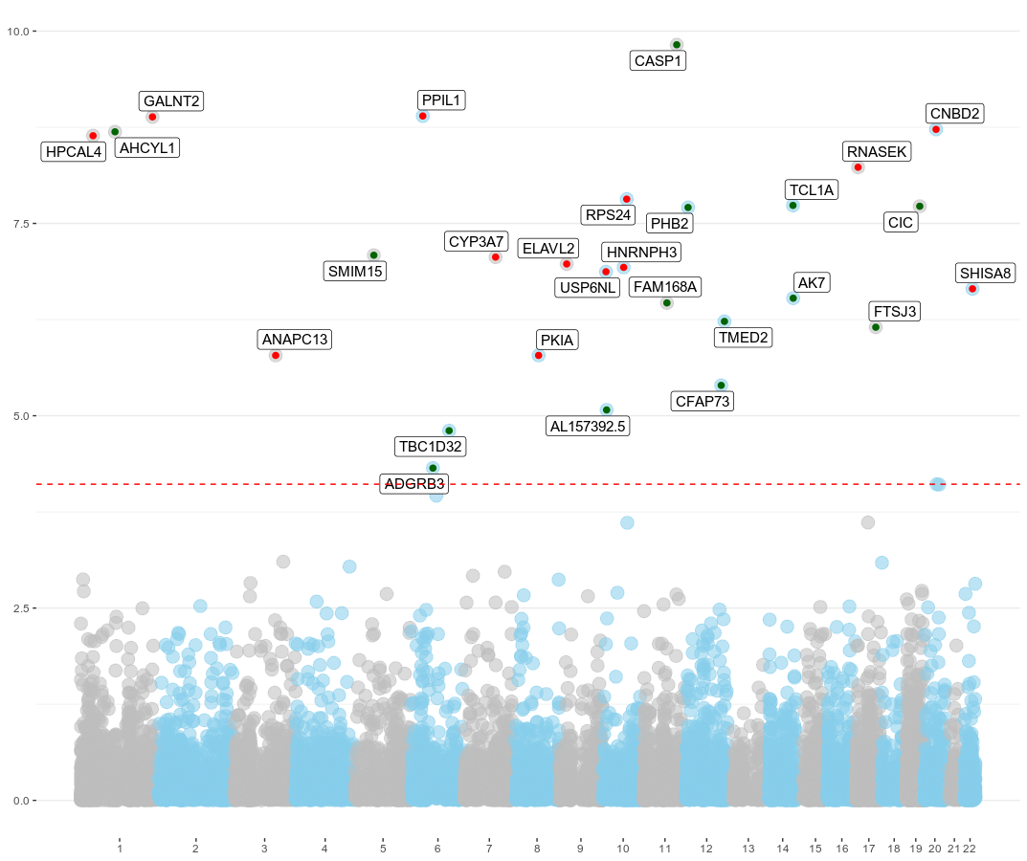
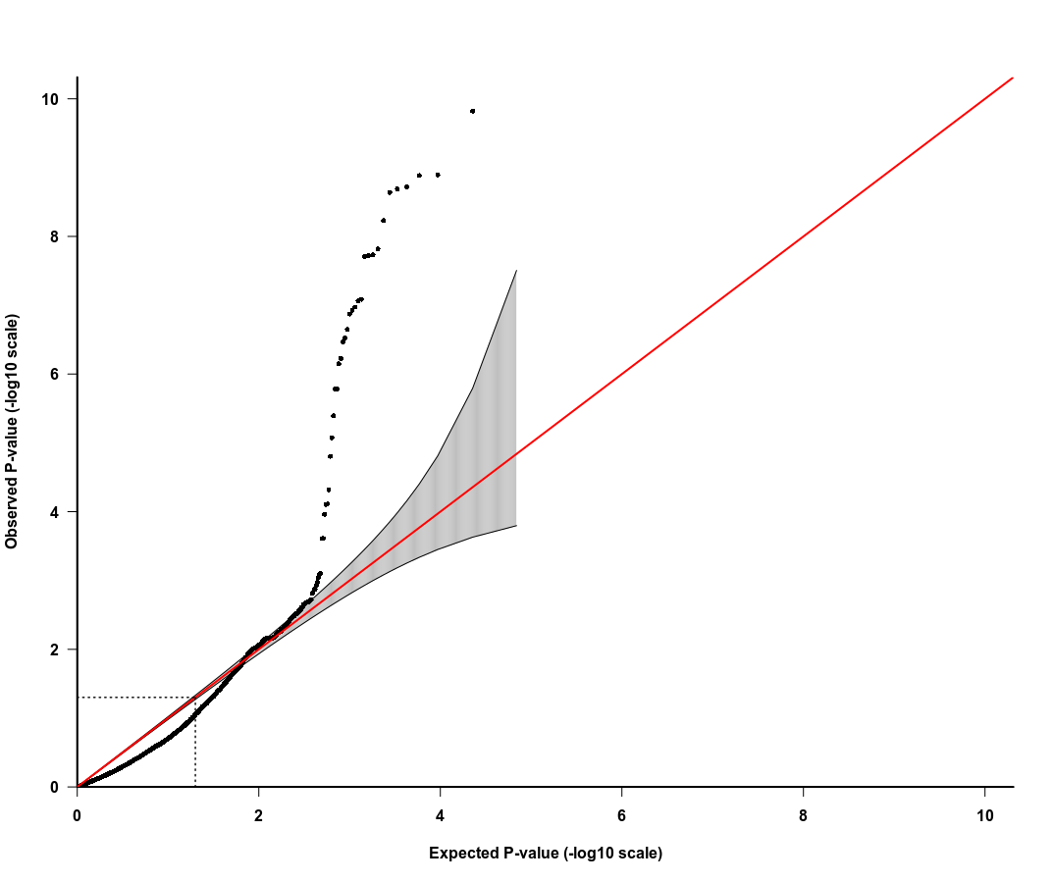
Malignancy proportion parametric p-values
observed p-value (-log10 scale)
FDR <0.05 threeshold
expected p-value (-log10 scale)

Slide 12
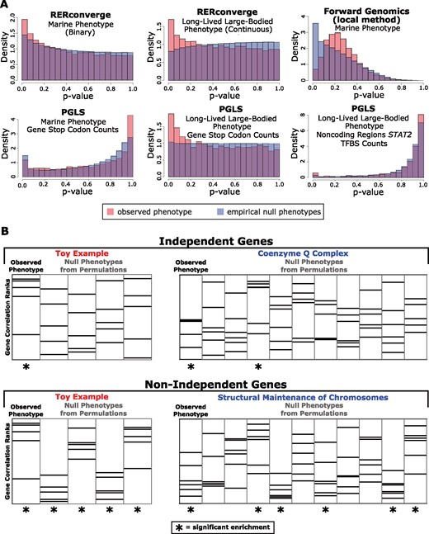
Use of permuLations
For a given phylogenetic comparative method (PCM), such as PGLS, permulations allow to:
explore the space of null expectation for p-values given a particular association method and a particular genomic dataset
recalibrate original p-values obtaining empirical p-values, reducing overestimation or underestimation of correlation significance due to PCM particularities
Malignancy proportion parametric p-values
observed p-value (-log10 scale)
Elysia Saputra, Amanda Kowalczyk, Luisa Cusick, Nathan Clark, Maria Chikina, Phylogenetic Permulations: A Statistically Rigorous Approach to Measure Confidence in Associations in a Phylogenetic Context, Molecular Biology and Evolution, Volume 38, Issue 7, July 2021, Pages 3004–3021
expected p-value (-log10 scale)

Slide 13
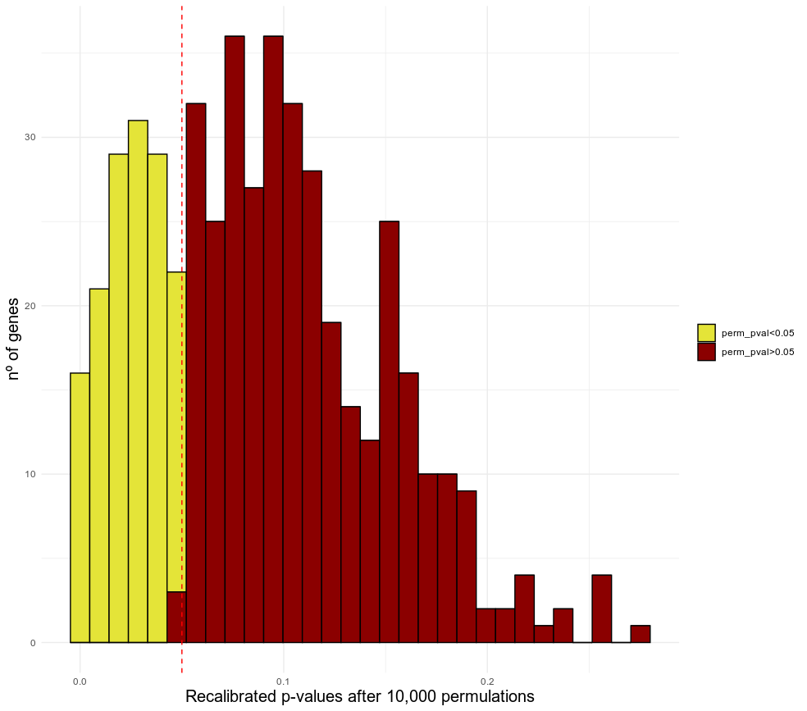
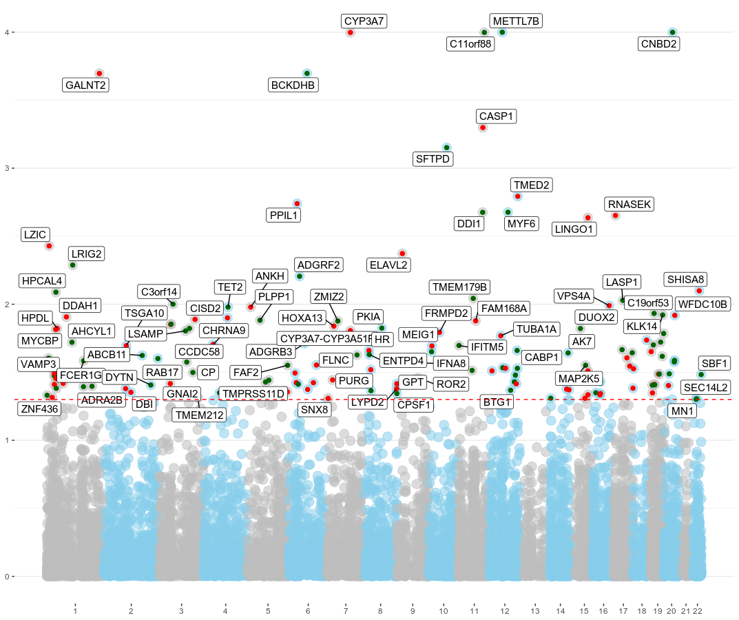
Malignancy proportion
permulated regressions
permuLations for nominally significant SNPs
parametric PGLS p-value < 0.05
permuLation p-value <0.05 threeshold
146 genes with permuLation p-value <0.05 & parametric PGLS p-val <0.05 (28.46% all nominally significant p-values)

Slide 14
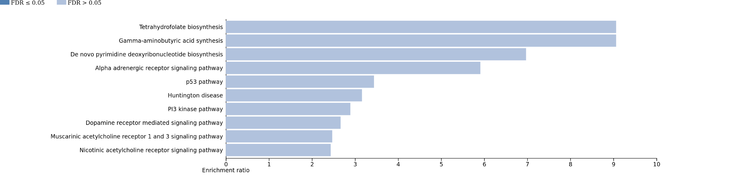
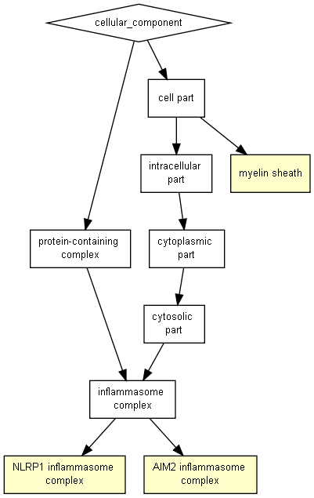
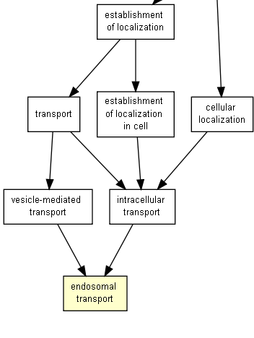
Malignancy proportion
functional enrichment
WebGestalt functional enrichment was used for parametric significant p-values and Gorilla Enrichment for the reduction to permulated significant p-values
Panther pathway enrichment
parametric PGLS p-val <0.05
permulated set p<0.05

Slide 15
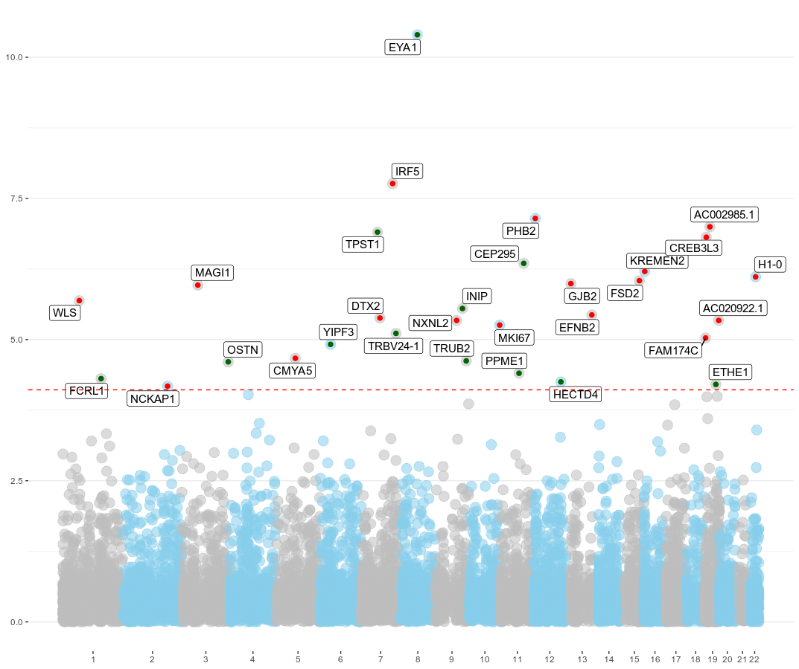
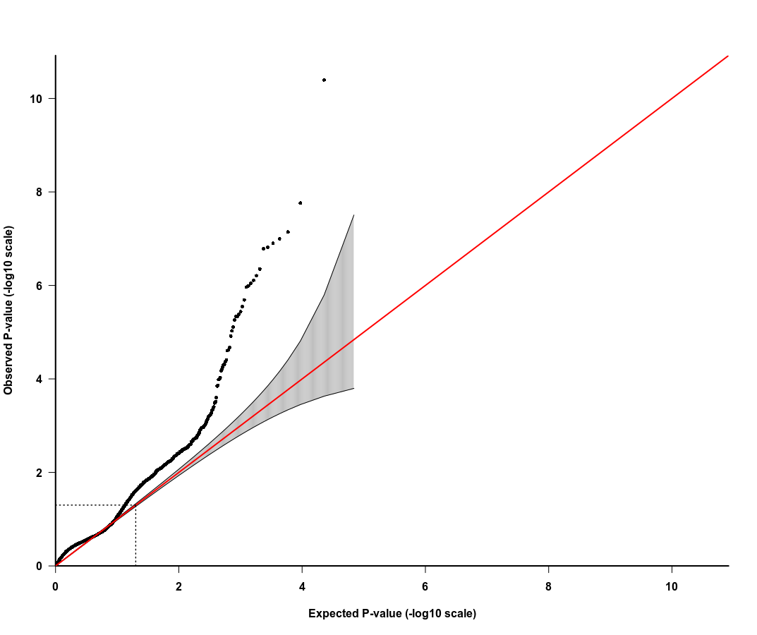
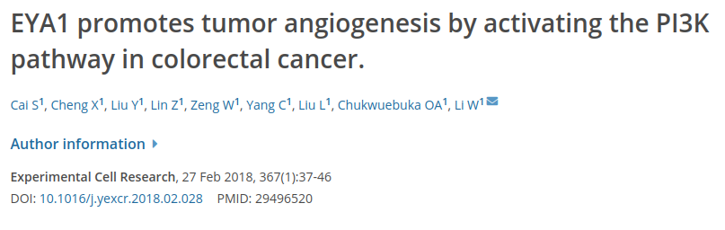
Neoplasy prevalence

Slide 16
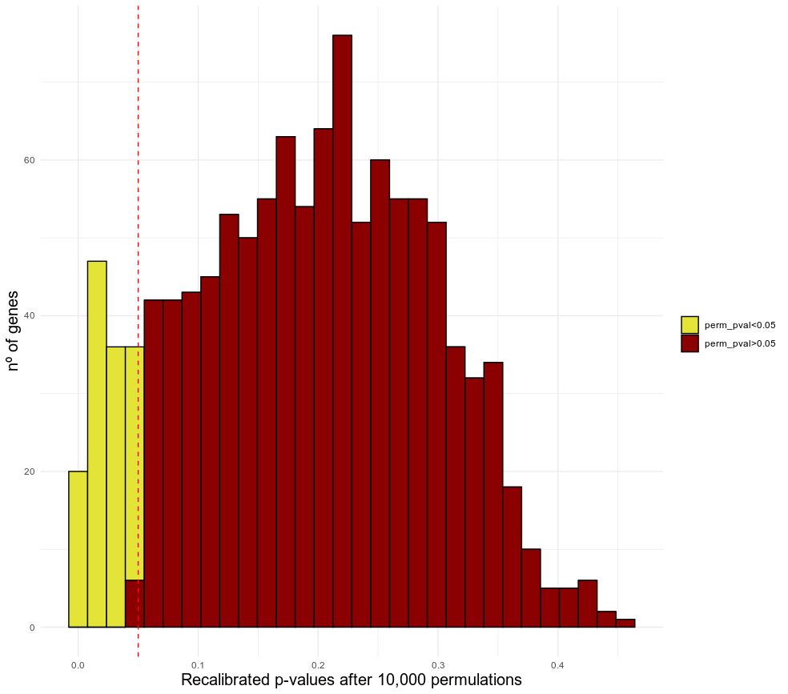
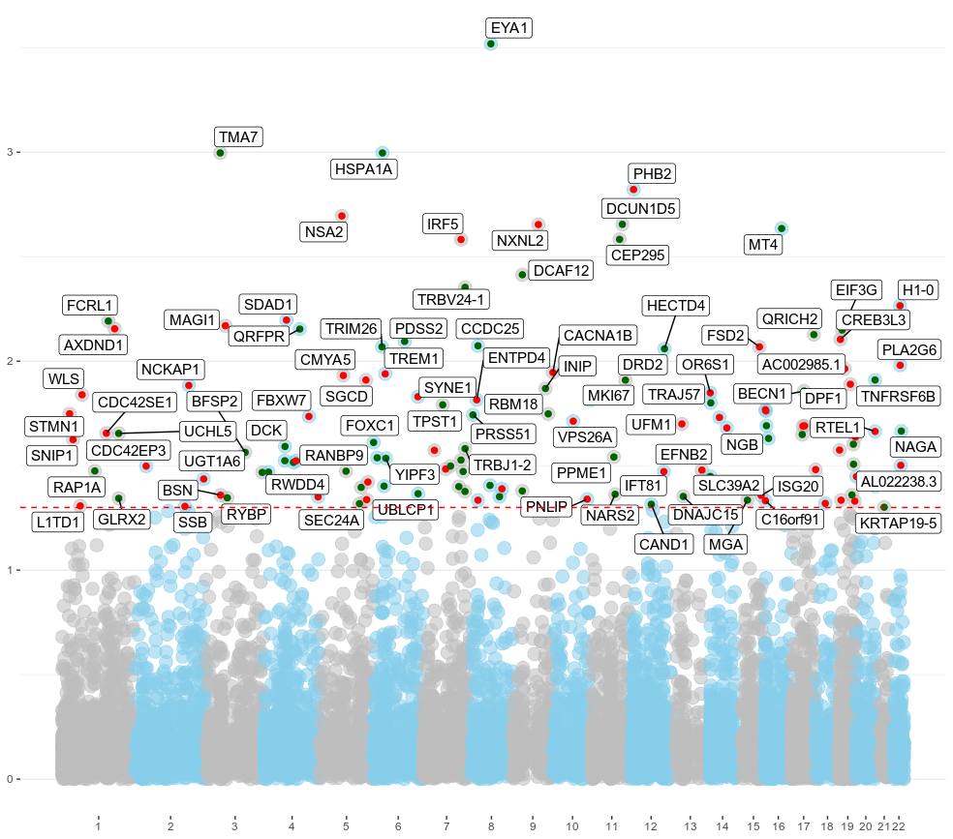
Neoplasy prevalence
permulated associations
permuLations for nominally significant SNPs
parametric PGLS p-value < 0.05
permuLation p-value <0.05 threeshold
134 genes with permuLation p-value <0.05 & parametric PGLS p-val <0.05 (11.42% all nominally significant p-values)

Slide 17
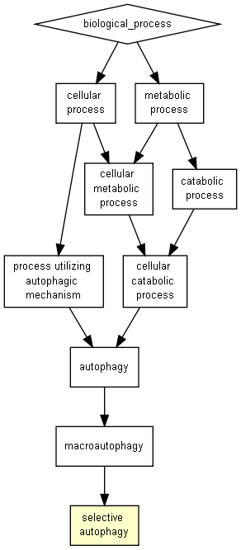
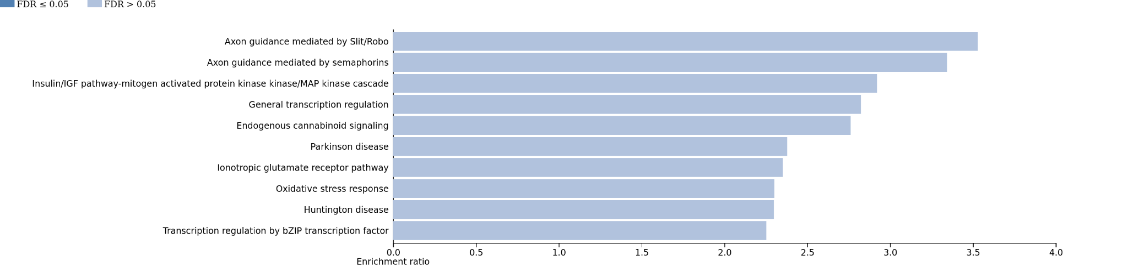
Neoplasy prevalence
functional enrichment
Panther pathway enrichment
parametric PGLS p-val <0.05
permulated set p<0.05

Slide 18
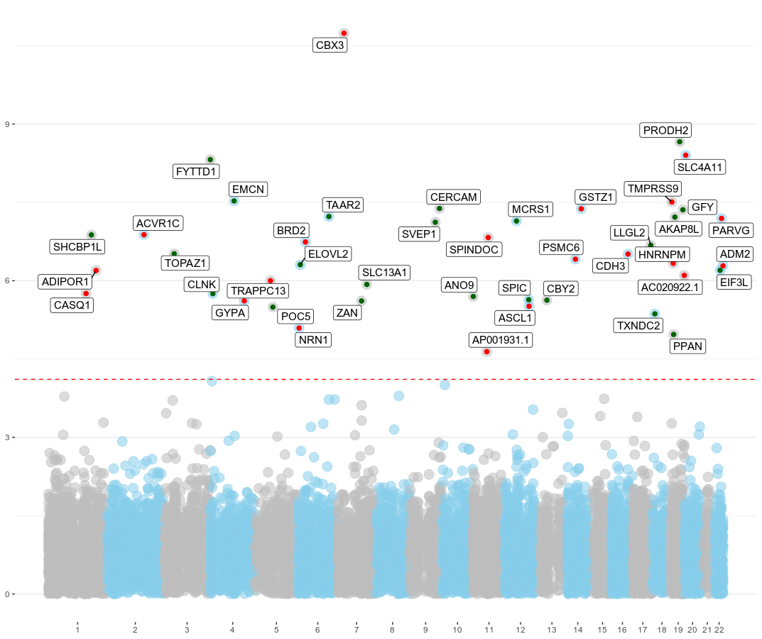
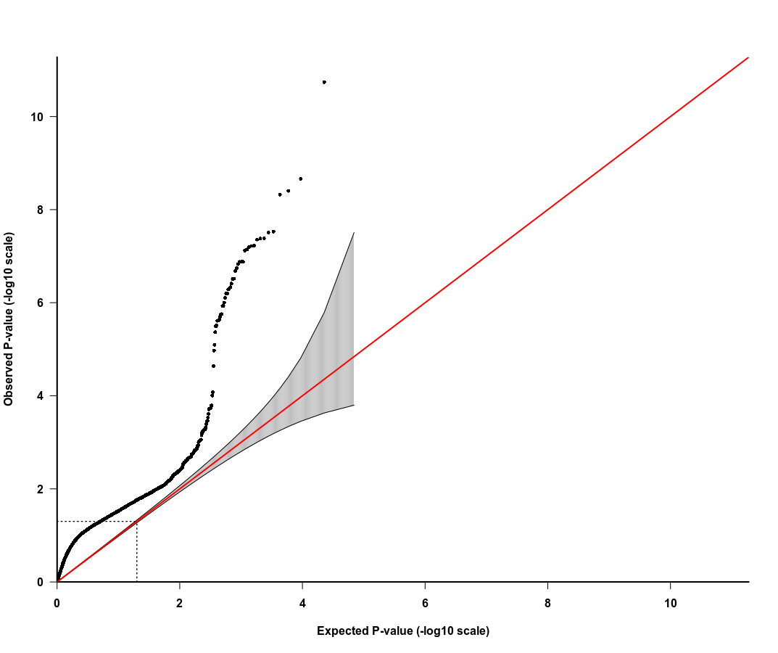
Benignancy proportion

Slide 19
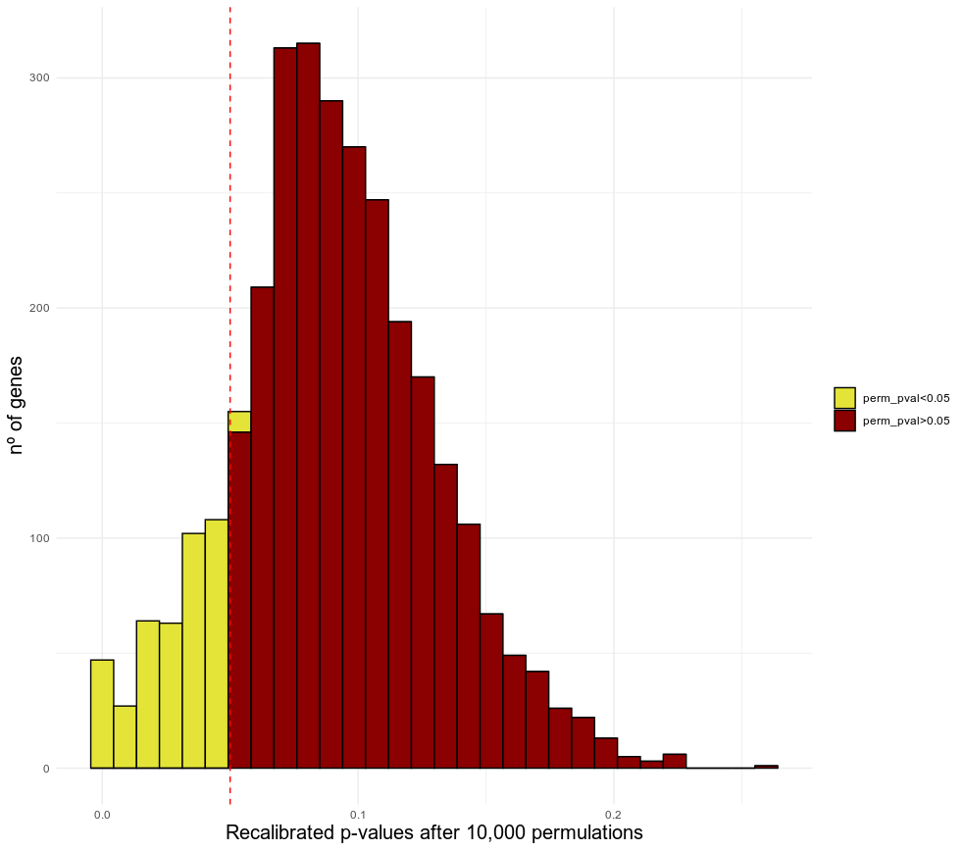
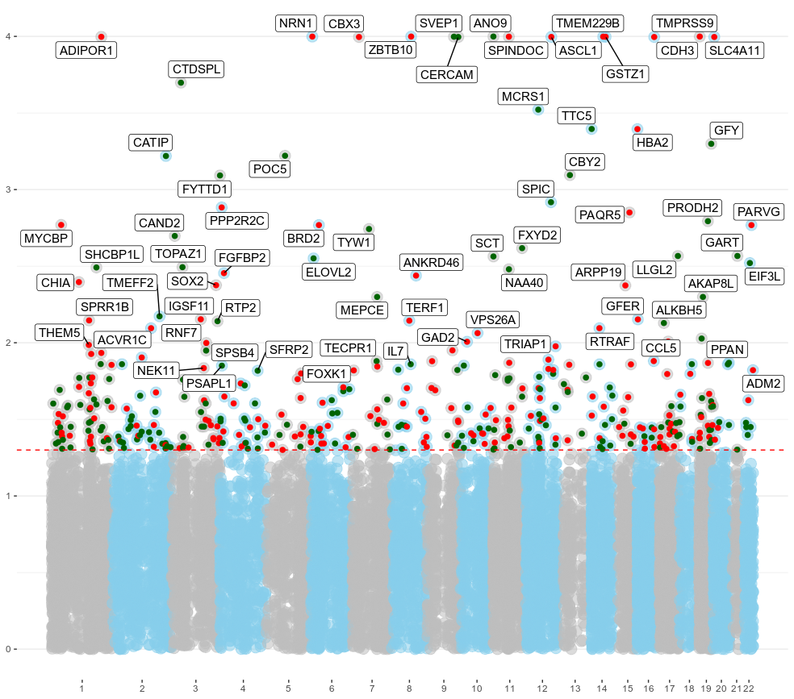
Benignancy proportion
permulated ....
permuLations for nominally significant SNPs
parametric PGLS p-value < 0.05
permuLation p-value <0.05 threeshold
420 genes with permuLation p-value <0.05 & parametric PGLS p-val <0.05 (13.57% all nominally significant p-values)

Slide 20
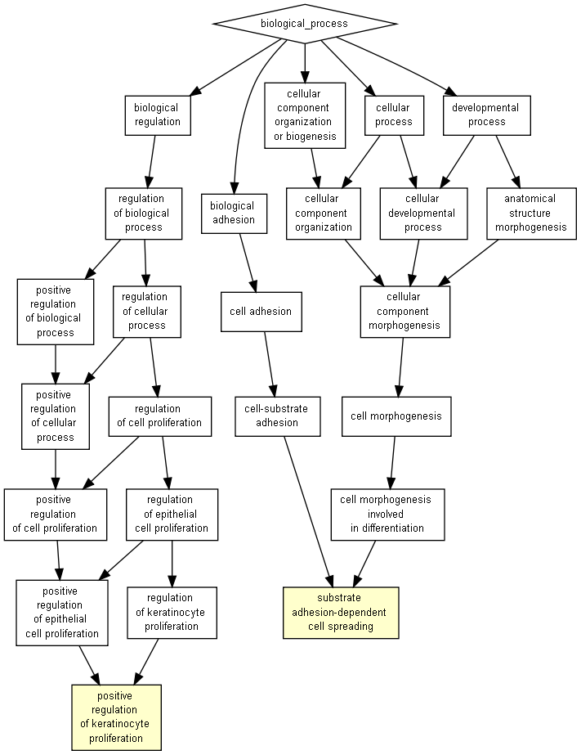
permulated set p<0.05

Slide 21
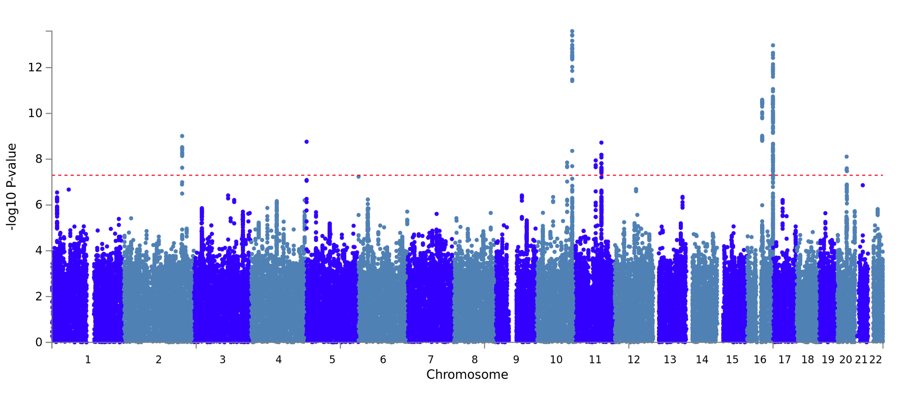
Malignancy proportion partitioned heritability
Malignancy proportion
Cancers diagnosed by doctor: Malignant, primary site
(GWAS Atlas ID: 3329)
Category | Prop SNPs | Prop h2 | Enrichment | Enrichment_p
PGLS p < 0.05 | 0.0738 | 0.1482 | 2.009 | 0.0898
Next in the todo list: look for other cancer GWASes and more

Slide 22
Next steps
Incorporate Convergent Amino Acid Substitutions (CAAS) between extreme species for the traits related to neoplasm proportions studied here and the available protein-coding alignments (currently working with their validation).
Look for more neoplasm-related summary statistics from human GWAS and ascertain the proportions of heritability explained by of our validated genesets.
Of course, to do what Carlos just suggested...

Slide 23


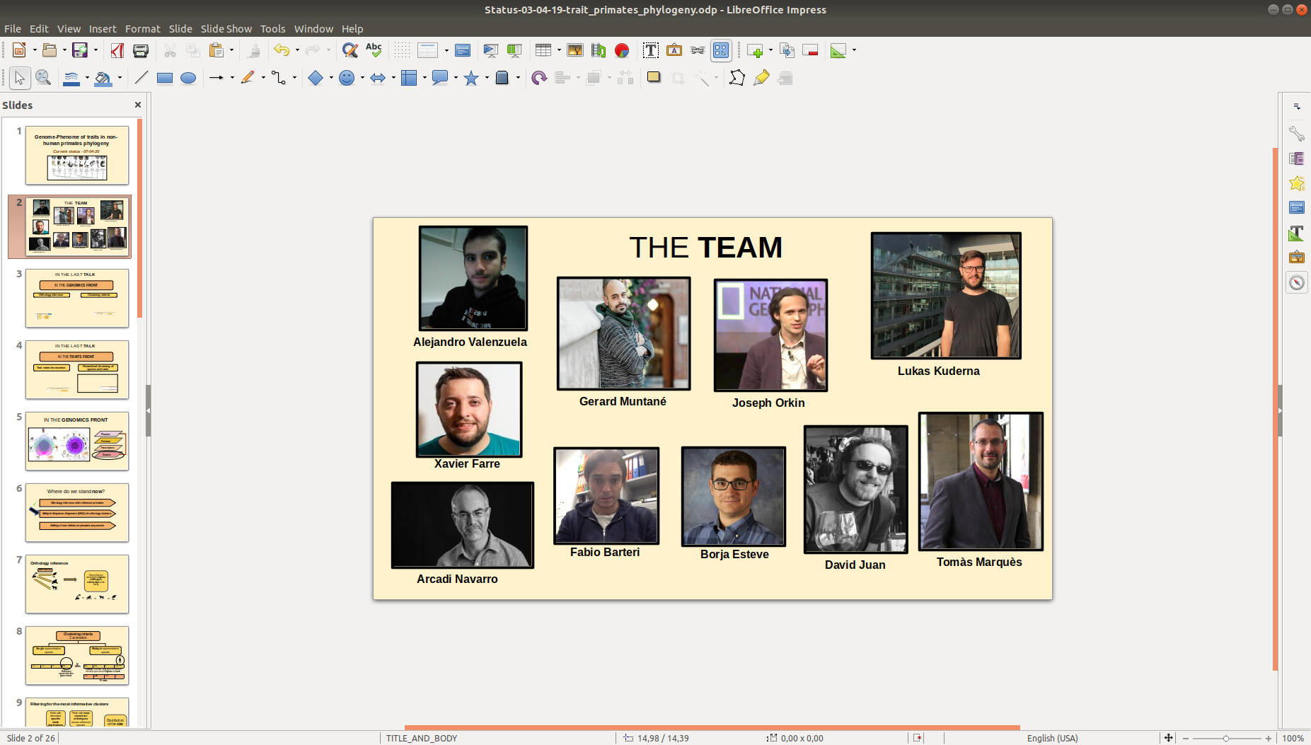
Acknowledgements
Comparative and
Evolutionary Genomics Lab
Arcadi Navarro
Gerard Muntané
David Juan

Slide 24

Any questions?
Thanks!!

